Slide 1
Target Practice
Roberto Panetta
Virgilio Jr Libo-on
Johnathan Heim
SebastIan Tomaszewski

Slide 2
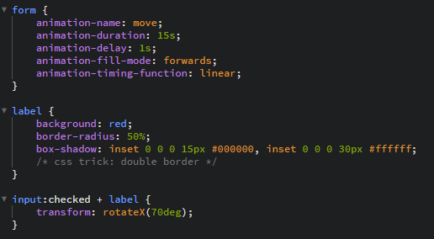
Targets

Slide 3
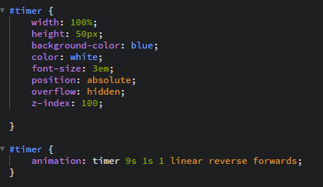
timer

Slide 4
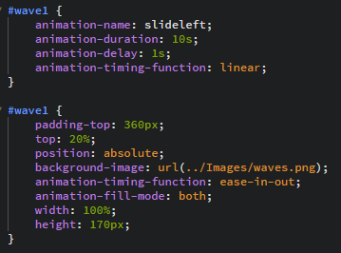
waves

Slide 5
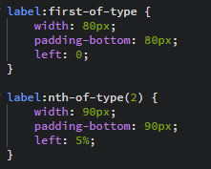
Size of targets

Slide 6
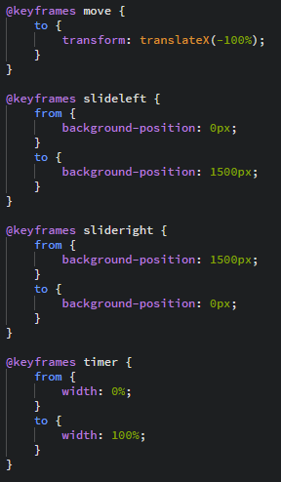
Key frames

Slide 7
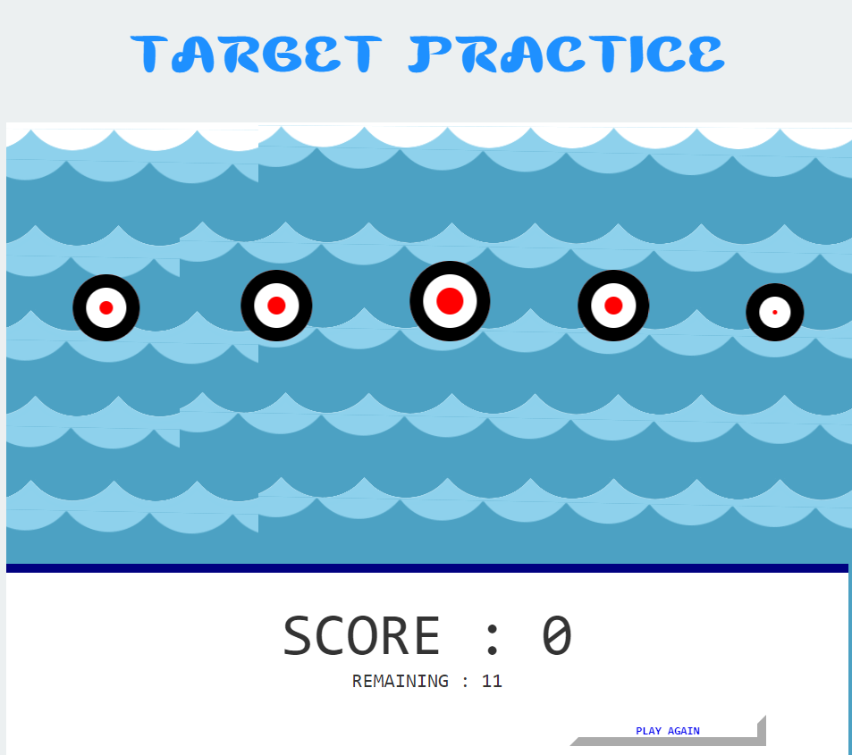
Thanks for your time!

